Slide 1
Covering the Risks of Medicare and Extended Care
Created by Presenters;
Diane Finnestead, MAT, Ed. S. and Kerry Ghormley, CLTC
Disclaimer: The information contained within this power point is the sole property of the two presenters listed above. Any and all duplication will need express written permission from the presenters.

Slide 2

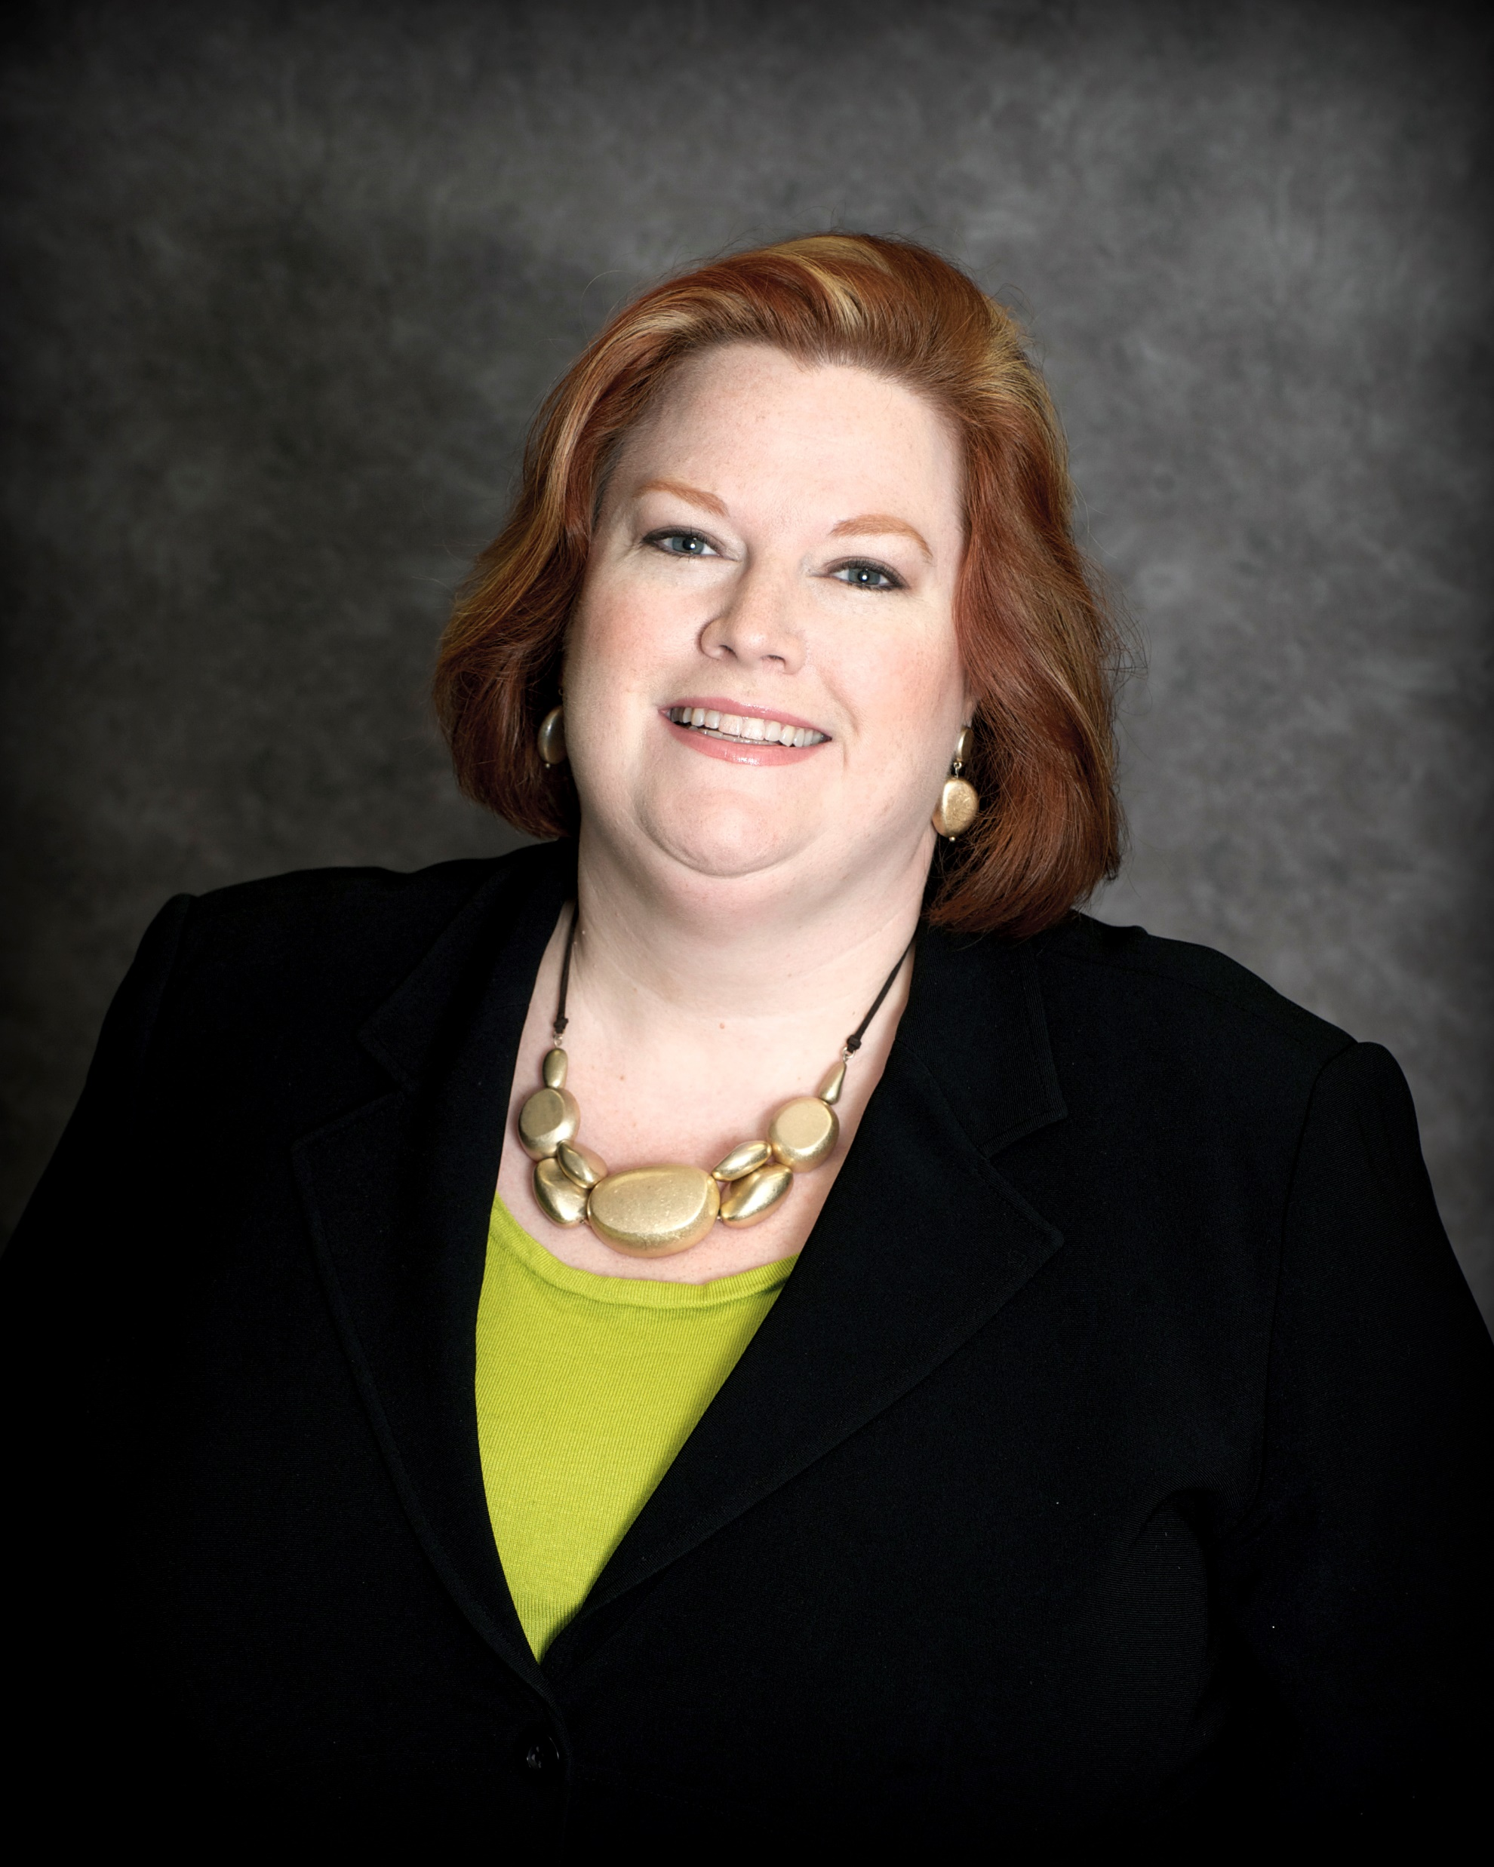
Diane Finnestead, MAT, Ed. S.
Kerry Ghormley, CLTC

Slide 3
Introductions and Getting to know you

Slide 4
Agenda
Notes:
Getting to know you
Who are you?
Have you conducted a conversation about Medicare? About Long-Term Care?
Raise hands
Do you Lead, Refer, or ignore the topic?

Slide 5
Why We Are Here at Merrill Lynch
      Protect clients at every asset and income level
      Provide compelling reasons why you must engage your clients in a discussion about Medicare and extended care
      Establish a basic skill set to engage your clients and expand your market
Notes:
@ Merrill Lynch-
We believe that understanding what matters most to you is critical to a successful investing strategy
We are able to design a comprehensive strategy around you
We believe trust comes from transparency
What happens to the financial plan you have put together for your client and they have a major health change?

Slide 6
Medicare Options
Original Medicare
Part A
Part B
Part C
Medicare Supplement
Medicare Advantage
Part C includes
Part A, Part B and sometimes D
Advantages
Notes:
66 Million people are on Medicare
44 Million people are on Medicare supplement
22 Million people are on Medicare Advantage
Medicare Advantage growing popularity is due to networks available in urban and suburban areas
Enrollment periods

Slide 7
Original Medicare – Pre Pay
Medicare Part A (Hospital Insurance)
Medicare Part B (Medical Insurance)
You can add:
Medicare Part D ( Prescription Drug Plan)
Supplemental coverage (Medicare Supplement/ Medigap)
Dental, Vision, Hearing, etc.

Slide 8
Medicare Advantage – Pay as you go
(Also known as Part C; Combination plan)
Part A
Part B
Usually, Part D
Extra Benefits known as Advantages; Vision, Hearing, Dental, OTC, Gym membership (ex Silver Sneakers), transportation, meals, etc.

Slide 9
Medicare Gaps
Original Medicare and Medicare Advantage
Inpatient vs. Observation
Hospitalist vs. Primary Care Physician
Rehabilitation
Home Healthcare
Critical Illness; Cancer, Heart, Stroke
Long Term Care
Notes:
On Original Medicare the gap is in-patient versus observation
An observation hospital stay equals that you must pay out of pocket for a skilled nursing facility rehabilitation stay
Medicare has a look back of one year to change the status. Hospitals in Medicare are making money by doing this and over $2 million people have been affected negatively
On Medicare Advantage the gap is Hospital and rehab, cancer and critical illness

Slide 10

What is the Biggest Gap?
Notes:
The Biggest Gap is Home health care, assisted living and nursing home care extended stay. These two can be broken down into 2 areas of Short-Term Care and Long-Term Care

Slide 11
Failure to have a discussion about extended care with your clients will have severe consequences to their families…

Slide 12
The Subject Matter
By definition, extended care is all-consuming
Those the client loves may have no choice but to set aside their lives to provide assistance and/or supervision on a 24 hour basis
This creates the first set of unintended and serious consequences…

Slide 13
First set of consequences:
The emotional and physical wellbeing of those your client loves

Slide 14
Emotional & Physical Well Being
Providing care to chronically ill people makes health caregivers chronically ill
It often forces a child to put their life aside, which can create its own set of consequences:
The relationship with his or her own family may suffer
The relationship with his or her siblings may become strained
LTC doesn’t bring families together… It tears them apart

Slide 15
Put simply, if your client ever needs care over a period of years, his life won’t end…
Someone else’s life will likely end

Slide 16
How to explain to your clients…
Many think extended care is a condition like Parkinson's, dementia or a stroke
Many also think it is a place like a nursing home or an assisted living facility
Extended care is a life changing event that has devastating consequences

Slide 17
Second set of consequences:
The financial viability of the family

Slide 18
Financial viability
If your business model is based on creating plans to
-Generate income during retirement
-Secure the financial viability of a surviving spouse
Paying for care will disrupt every aspect of your business model

Slide 19
What is the Plan?
The plan is to allow your client
to remain safe,
in the community,
while preserving the emotional,
physical and financial
wellbeing of those they love

Slide 20
Some ideas on how to address the subject with your client:
The 4 Key Agreements

Slide 21
The 4 Key Agreements
Engaging in the Extended Care Conversation;
Do you realize…
This can happen to …you?
All other insurances are in place- this is the greatest risk you face?
You’re paying for your extended care out of your pocket- you are currently self funding this risk?
A small portion of your money/dividends can protect you from the greatest financial risk you face?

Slide 22
The focus of the discussion must be to educate the client about the severe consequences an unexpected need for care would have on their family.
Once the client understands how severe the consequences could be to the emotional, physical and financial wellbeing of their family, they will let you create a plan to protect them from an event they still believe may never happen.

Slide 23
Who pays for Long-Term Care?
Who pays for short-term care?
Notes:
Who pays for Long-Term Care and How much does it cost?
Partnership Program

Slide 24
The Extended Care Timeline
Starting with Short-Term
Homecare
Hospital
Homecare
Rehab
Homecare
Outpatient
Homecare
Short Term
Long Term
.
Notes:
The continuum of care
Kerry’s mom’s story and Di’s family story

Slide 25
The Extended Care Timeline
Continuing into Long Term
Homecare
Your residence
Adult Day Care
Assisted Living
Pathway to safety
Memory Care
Nursing Home
Skilled Care
24/7

Slide 26
Case Study #1
Alan and Camille
They are both 78
They have 2 children

Slide 27
Alan and Camille
Their house is paid off and worth $400,000
Their retirement portfolio is worth $1,000,000:
$700,000 in qualified funds
$250,000 in stock
$50,000 in cash
Income: SS: $40,000; $40,000 from qualified funds
His passion is golf. Camille rides horses. Both love to travel and they have a house in Florida
They have a child who has not made the best decisions and are helping to pay for their grandchildren’s education

Slide 28
Camille is diagnosed with Alzheimer’s

Slide 29
What has been allocated from the retirement portfolio and their income to pay for her care over the next 8 to 10 years?

Slide 30
All of it…
Where else can the funds come from?

Slide 31
Alan is now faced with how to pay for his wife’s custodial care.
He looks into…

Slide 32
Medicare, but finds it won't pay for custodial care
The VA, but again is told it’s not an option given his assets and income
Medicaid and this time he learns it will pay for custodial care, but almost exclusively in a nursing home. Alan promises himself it’s the last option but wants to know what would happen if he needed the program. He finds out…

Slide 33
That to qualify for benefits he would have to give his assets away
The problem is that they consist of low cost based investments and qualified funds the gifting of which would create substantial taxes.
He also finds out that once Camille qualifies for Medicaid he will lose her entire pension
In effect he finds out that Medicaid is not free

Slide 34
In an effort to preserve his income and assets he provides the care himself creating an unintended consequence that will end up devastating his children…
His health starts to fail to the point where a child has no choice but to step in and assist
What does that do to her health and the relationship with siblings who do not help out?

Slide 35
Camille has Alzheimer’s

Slide 36
Her husband and children suffer from it

Slide 37
What if they had a plan in place?
Notes:
Illustrate LTC benefit and Partnership program
LTC/Life option do NOT qualify for partnership program

Slide 38
Case Study #2
Bruce and Sophia
Bruce is 69, Sophia is 58
They have 4 children
(3 are from Bruce’s 1st marriage and 1 is theirs together)

Slide 39
Bruce and Sophia
Their current house has a mortgage of $250,000
Their retirement portfolio is worth $5,000,000:
$3,500,000 in qualified funds
$1,150,000 in stock
$350,000 in cash
Income: SS: $50,000; $200,000 from qualified funds
Bruce is retired, but still does some consulting. Sophia is still working, but plans to retire in 2 years from teaching. They enjoy their vacation home in CO.
Their youngest child starts college next year. They have 5 grandchildren under the age of 10.

Slide 40
Bruce suffers a debilitating stroke while skiing on vacation with his oldest son

Slide 41
After being stabilized at the area hospital Bruce is transferred to a rehab facility. He is there for 63 days. Once he is stabilized, the family chooses to move him back to St. Louis.
The family now must decide whether Bruce will receive care at home, or in a facility.
Notes:
FACILITIES PREFER INSURANCE OVER YOUR MONEY
Competition for good facilities

Slide 42
A view from 30,000 feet…
Creating and funding a plan
for extended care
will preserve EVERY
other plan you have established

Slide 43
Are you a partner in solving the Healthcare Crisis?
We implore you to no longer accept the consequences of ignoring the risks to your clients and your book of business
Are you ready to lead the healthcare and extended care conversation?
Are you ready to turn over the responsibility of the Medicare and Long-Term Care solutions to the experts so we can provide the ongoing service?

Slide 44
We are ready to be your resources and partners

Slide 45
Thank You!
Any Questions?

Slide 46
Diane Finnestead MAT, Ed. S.
dianef88@sbcglobal.net
314-302-5743 (text preferred)
314-920-3990 (call to schedule an appointment)
Kerry Ghormley, CLTC
kghormley@gmail.com
314-276-8897 (cell phone)
314-405-8888 ext. 105 (office)

