Slide 1
Five Steps from Network to Net worth;
1 Thank-you at a time
Diane Finnestead MAT, Ed. S.

Slide 2
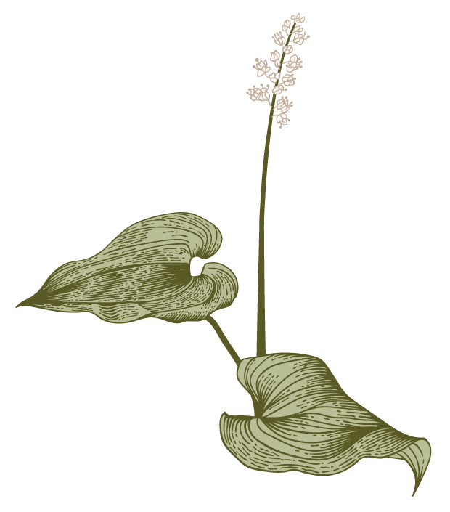

Agenda; 5 Steps
A
1. Focus your Vision
2. Know your Strengths
3. Be the Solution
4. Make the Connection
5. Express Gratitude
*A thank you is free but when not given, it’s expensive!

Slide 3
Step One
Focus your vision

Slide 4
Focus your vision
Resumes, cover letters, follow-up letters – start with the end in mind-Wiggins
S.M.A.R.T. Goals
Picture your life one year, two years, five years and ten years
What motivates you?
What moves you?
Where have you been and where are you going?
*To change your direction, you must already be in the driver’s seat.

Slide 5
Step Two
Know your Strengths

Slide 6
Know your Strengths
And weaknesses too
Resources; Kelly Merbler; Coffee with Kelly/ John Maxwell, “What Color is your Parachute”, Meyers Briggs, DISC assessment
Get in the Flow; The Energy Bus
Chart your course- Reward yourself- Change your words to “I get to…”
First to thine own self be true; be your best friend and count yourself in- Shoot YOUR shot
That which does not kill us, makes us stronger-Nietzsch ~
Anyone in here feel like Hercules or Wonder Woman???

Slide 7
Step Three
Be the Solution

Slide 8
Be the Solution
Jobs and opportunities are created because there is a problem to solve~ Anon
Get curious & ask yourself; Do I want to solve this problem?
Then ask yourself Who, What, Where, Why, When and How?
Who has the problem?
What problem I solving?
Where is the mot impact towards solving the problem?
When do they want it solved and when can I solve it?
Why do they have this problem? Why am I the one to solve it?
How soon can I start solving this problem?
If you define the problem, you most always find the solution~ Steve Jobbs

Slide 9
Step Four
Make the Connection

Slide 10
Make the Connection
It’s not what you know but who you know ~ Anon
When people quit (anything), they have only reached 40% of their potential ~ Gateway to Dreams
Perfection kills Connection
Ask Who, What, Where, Why, When, How? Prepare- use technology and a mirror
Who do I want to meet? Rule #1- If you are comfortable, they are comfortable
What kind of conversation do I want to have?- Giver’s Gain- BNI
What do I ask? FORD- Family, Occupation, Recreation, Dreams
Where, When and How can I support you? And, the Golden question by Brian McCray 7L Mastermind St. Louis
Plan your follow up time to equal the event time and say thank you!

Slide 11
Step Five
Express Gratitude

Slide 12
Express Gratitude
How do I say thank you?
Have a plan to continue your connection- State it, Date it and Follow it
Formal thank you note is about them, “You” statements, recognition and impact, handwritten in blue ink, mailed through the US Postal Service
Send a book or story you wrote or have read – explain how it changed your life or thinking and references your conversation or incapsulates your connection
Invite to an event you are giving, hosting or attending with the value statement about them as to how they will reach their goals by attending- Time is a gift and knowledge is a gift
Recognize or highlight their accomplishments in social media with permission of course
Keep a daily gratitude journal
Benefits of gratitude; Makes you happier and healthier, replenishes willpower, reduces stress, creates better sleep, improves health, makes relationships stronger, etc!
When someone brings you a “problem”, say thank you because they would not have brought it to you without thinking you could solve it- so the next time you hear

Slide 13
Reviewing our Agenda; 5 Steps
A
1. Focus your Vision
2. Know your Strengths
3. Be the Solution
4. Make the Connection
5. Express Gratitude
*A thank you is free but when not given, it’s expensive!

Slide 14
Make your gratitude and thank you count!
From Network to your Net worth;
1 Thank-you at a time

Slide 15
Contact info:
Diane Finnestead, MAT, Ed. S
Text 314-302-5743 or Text 314-920-3990
Health Insurance Broker
Ages 0-103, 20+ States, 20+ years,
Individuals and Small Groups, Young and Old and in-between!
Avoid COBRA, Save thousands, Text PP or A
1

